Slide 1
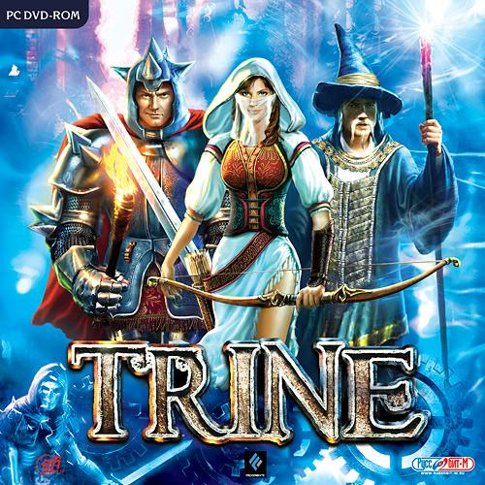
Design for Game and Play
An analysis of Trine
By Twan van Schijndel
Kevin Cleijne
Guus van der Weerd
Joep klein Teeselink
Jeroen van Hoof

Slide 2
TRINE!
insert video here

Slide 3
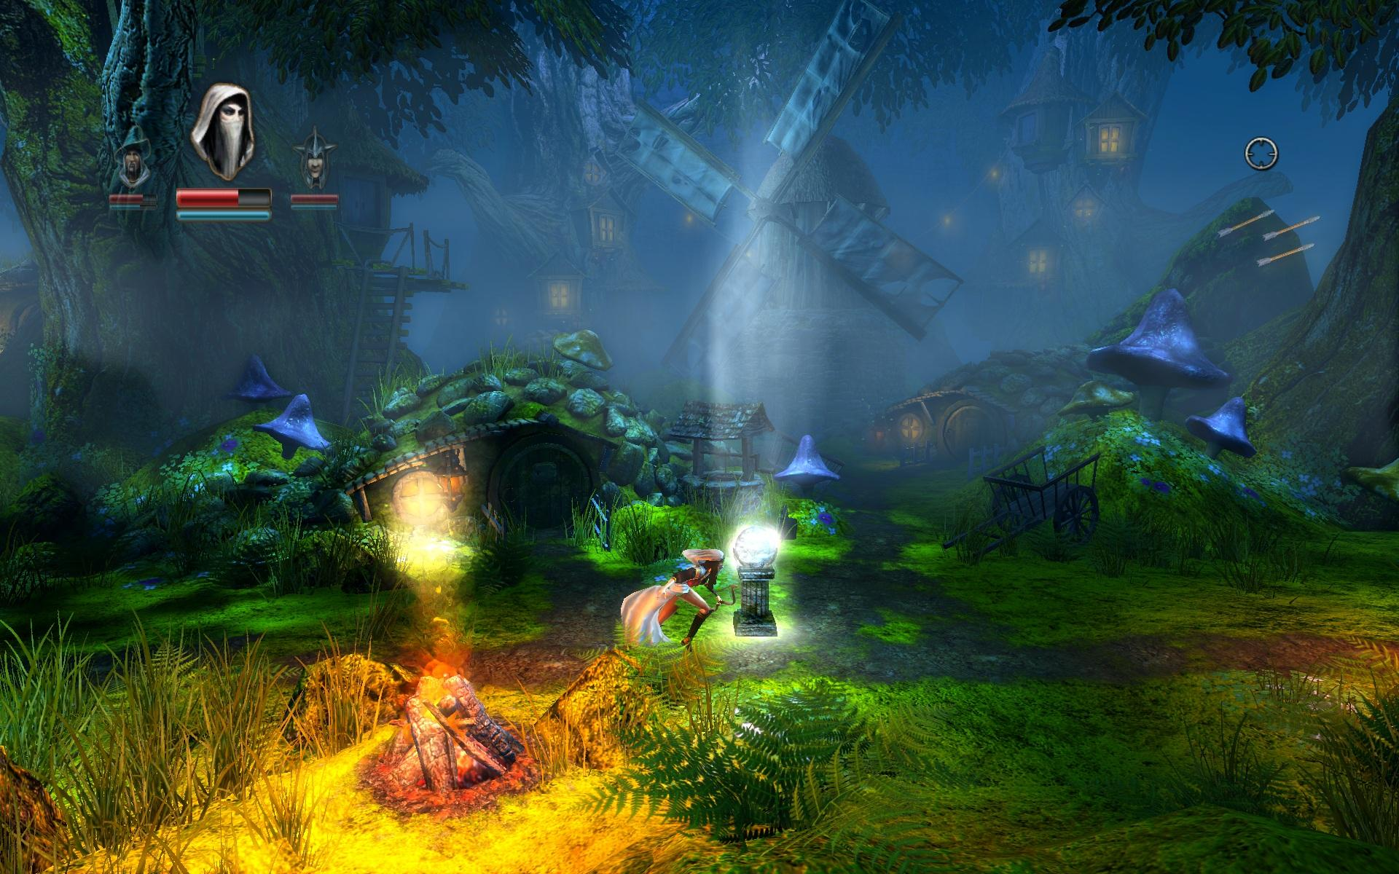
What makes
Trine a game?

Slide 4
Why is Trine fun?
-A sense of accomplishment after solving a puzzle
-Rewarded by story, visuals and items
-Increasing difficulty
-Learning and experimenting

Slide 5
Gameplay Elements
Collectables
Puzzle Solving
Character Progression (leveling skills)
Exploration, platforming
Story Progression
‘Twitch Skill’ and Combat elements
No frustrating deaths (generous checkpoints)

Slide 6
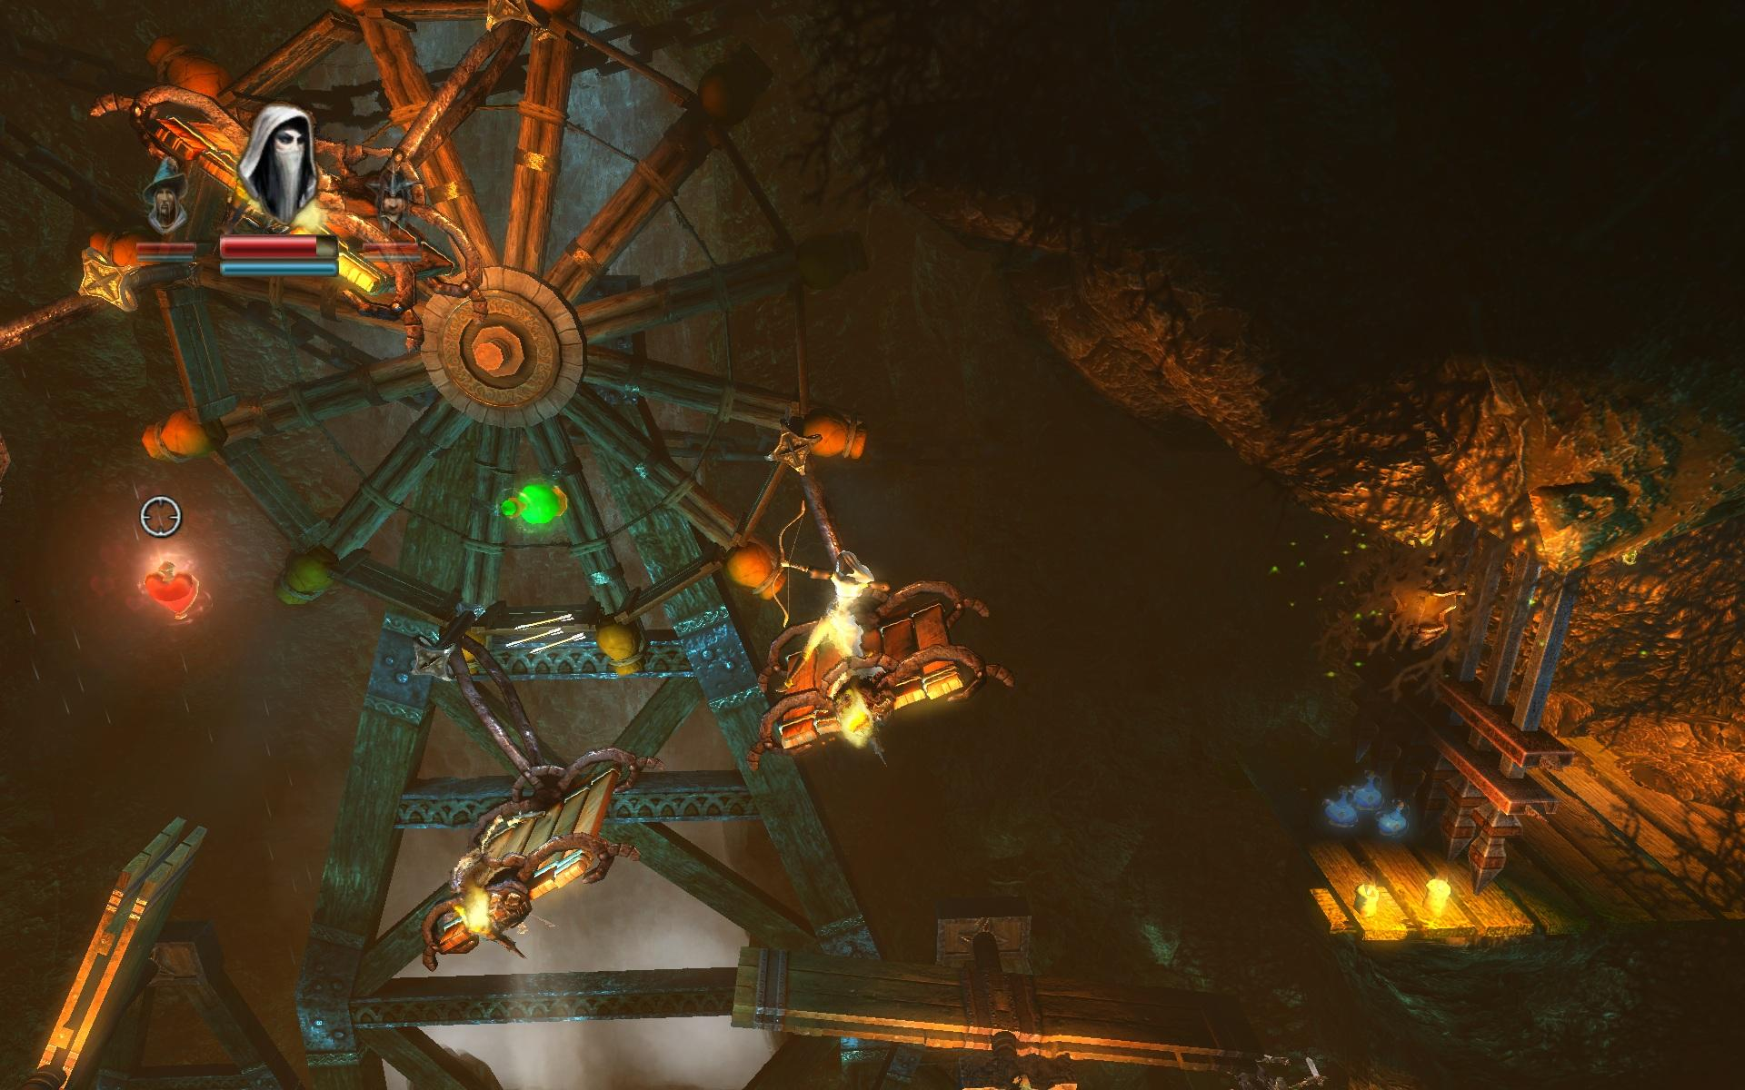
Execution of Game Mechanics
Collectables
Puzzle Solving
Character Progression
Exploration, platforming
Story Progression
‘Twitch Skill’
Death System
Collectables:
Rewards encourage Exploration

Slide 7
Execution of Game Mechanics
Puzzle Solving
- Challenges the player
- Aestetic encorporated in puzzle design
=> Beauty
- Desire for story progression
- Sense of acomplishment when successful
Collectables
Puzzle Solving
Character Progression
Exploration, platforming
Story Progression
‘Twitch Skill’
Death System

Slide 8
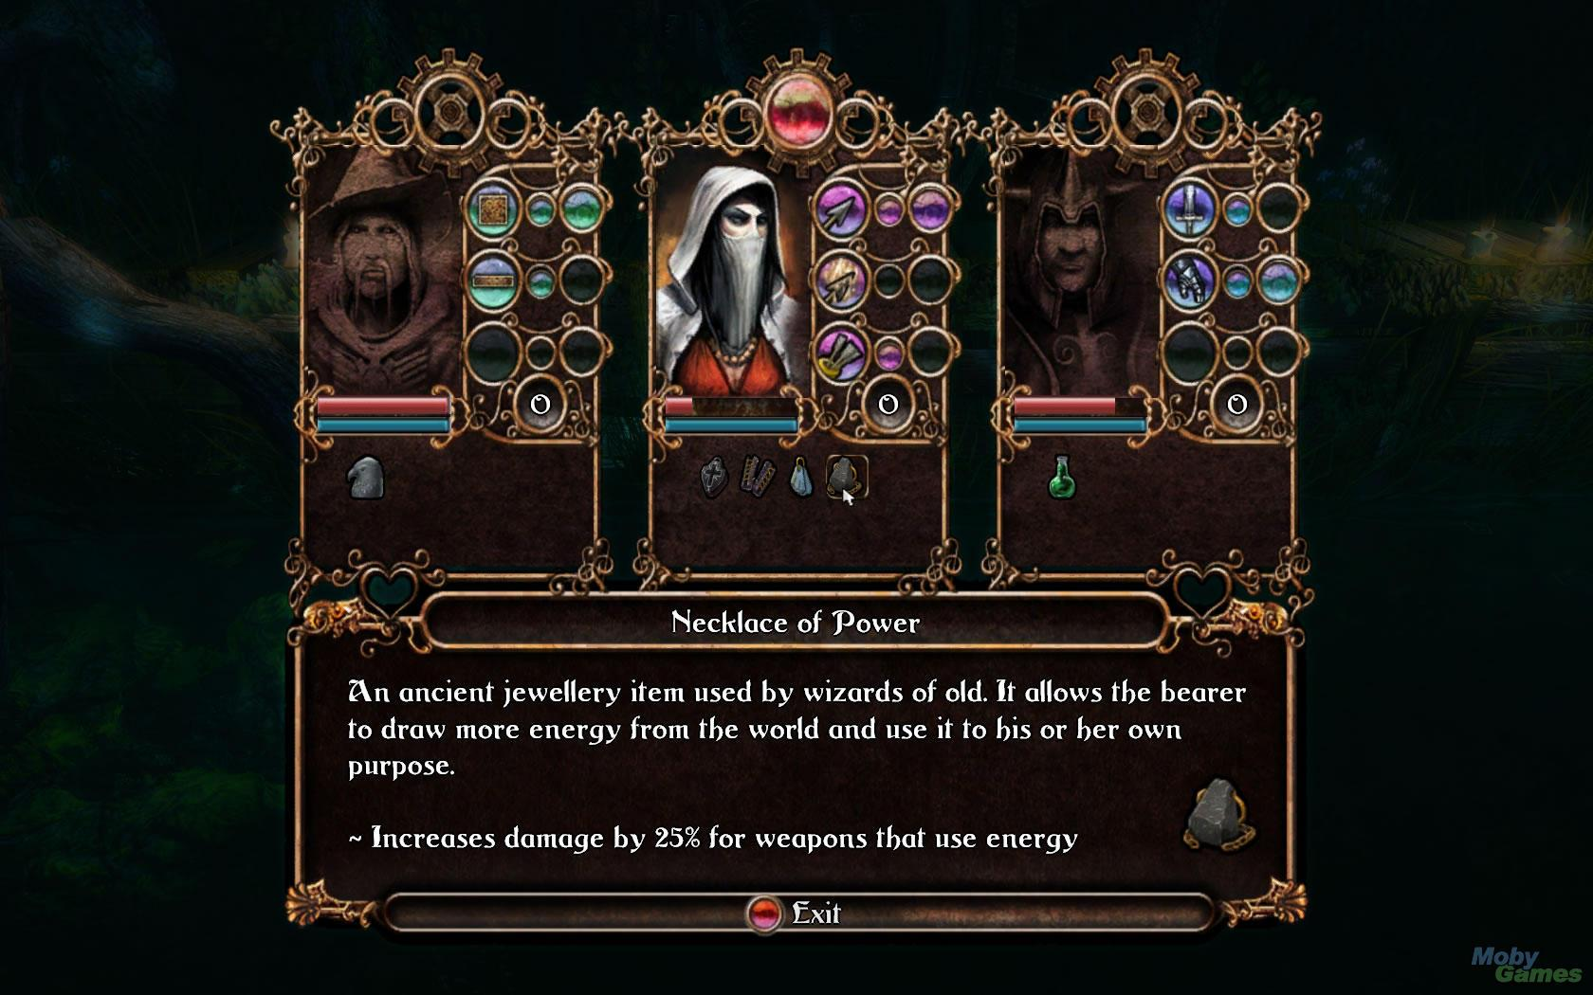
Execution of Game Mechanics
Collectables
Puzzle Solving
Character Progression
Exploration, platforming
Story Progression
‘Twitch Skill’
Death System
Character Progression:
Leveling system and story for each character

Slide 9
Execution of Game Mechanics
Exploration and Platforming:
- Precise movement required
=> Challenges player
- Wanderlust and awe-factor
- Desire to ‘see what comes next’
- Cohesive theme of fantasy world
- Manipulate the world => find hidden areas
Collectables
Puzzle Solving
Character Progression
Exploration, platforming
Story Progression
‘Twitch Skill’
Death System

Slide 10
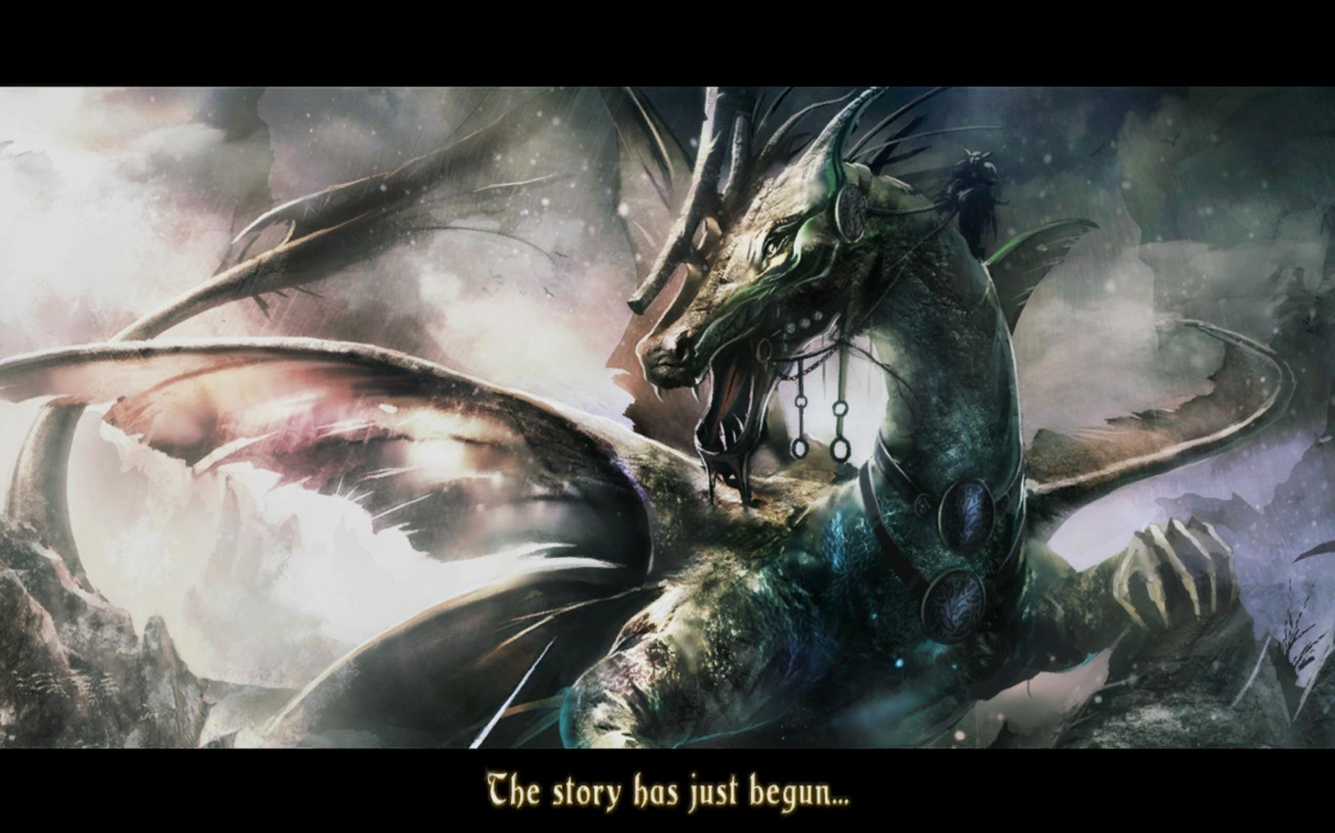
Execution of Game Mechanics
Collectables
Puzzle Solving
Character Progression
Exploration, platforming
Story Progression
‘Twitch Skill’
Death System
Story Progression:
Desire to see what comes next

Slide 11
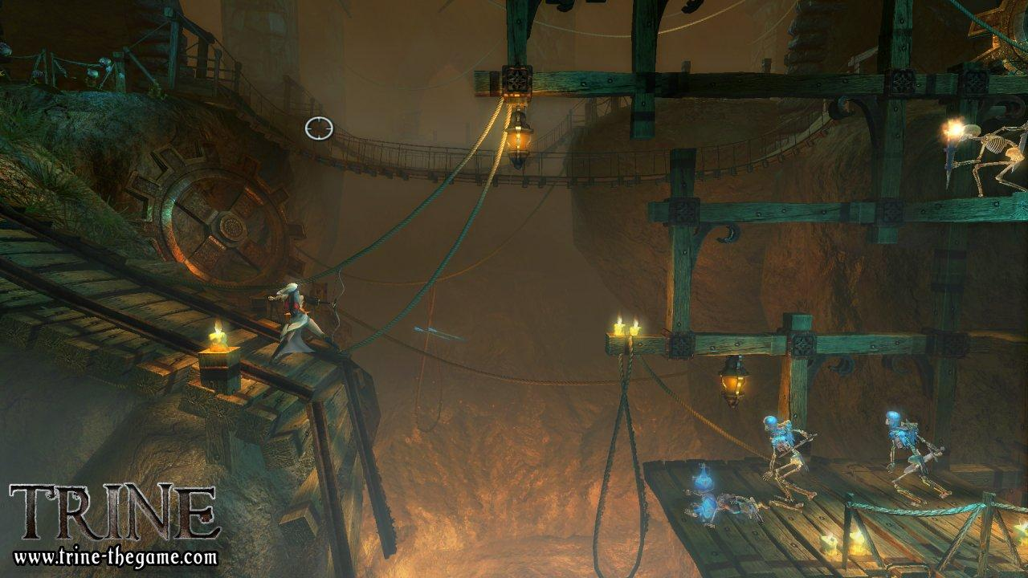
Execution of Game Mechanics
Collectables
Puzzle Solving
Character Progression
Exploration, platforming
Story Progression
‘Twitch Skill’
Death System
‘Twitch Skill’:
Avoid hazards, time jumps and fight!

Slide 12
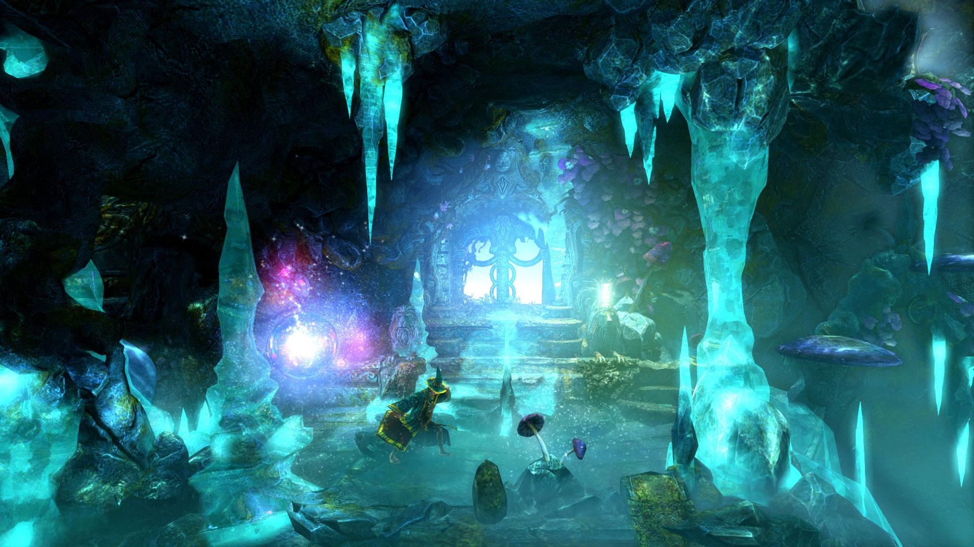
Execution of Game Mechanics
Collectables
Puzzle Solving
Character Progression
Exploration, platforming
Story Progression
‘Twitch Skill’
Death System
Death System:
Character loss and checkpoint system

Slide 13
Experiental System
Objects: Players, AI.
Attributes: Playable characters, environment in Trine.
Internal Relationship: Player vs player vs AI.
Environment: Context of play.

Slide 14
Our opinion on Trine
+ Beautiful artsy stuff
+ Good and original environmental puzzles
+ Great use of different characters
- Unsatisfying combat
- A bit on the easy side

Slide 15
Thank you
for your attention

